Slide 1
Managed Memory Leak Investigation
Workshop
Michael Yarichuk

Slide 2
Possible symptoms of memory leaks
Slowdowns
Execution pauses (freezes)
High resource usage (CPU/RAM)
Obviously – constantly growing memory!

Slide 3
This workshop is about working in Windows!
Working with dumps on Linux requires usage of different tools, but roughly works the same

Slide 4
A word (or two) about garbage collector
Part 1

Slide 5
GC Algorithm Types
Manual - allocate/release via language API
Reference counting – allocate via language API, release via reference count
Mark-sweep
Others (rare!)
Used by the CLR
https://courses.cs.washington.edu/courses/csep521/07wi/prj/rick.pdf

Slide 6
.Net Garbage Collector
Pause EE (Execution Engine)
Mark
Sweep
Compact?

Slide 7
Mark Phase
GC Root #1
A
B
C
GC Root #2
X
Y
F
G
H

Slide 8
Sweep phase
All objects marked as unreachable are freed
Objects with finalizers are moved to finalization queue

Slide 9
Compact
Allocated
Free
Allocated
Allocated
Allocated
Allocated
Free
Allocated

Slide 10
Compact
Allocated
Allocated
Allocated
Free
Allocated
Allocated
Allocated
Free

Slide 11
GC Roots
Starting point for Mark Phase iteration
GC Roots and any objects they reference are not released​!

Slide 12
GC Roots
Static references
Stack references (roots for duration of method execution!)
Handles (for p/invokes & unmanaged)
F-reachable queue references (more on this later!)

Slide 13
Shortest retention path
GC Root
B
C

Slide 14
GC Generations
Gen 0
Gen 1
Gen 2
LOH

Slide 15
GC Generations
Newly allocated objects start at Gen 0
Objects surviving a GC are promoted to next Gen
Bigger Gen = less frequent GC

Slide 16
Finalization & F-reachable queues
Object with Finalizer is allocated
Object added to Finalization Queue
GC "releases" the Object
Object added to F-reachable Queue
GC Finalizer takes object from F-Reachable and executes Finalizer
GC actually releases the Object

Slide 17
Memory Fragmentation
When CLR GC frees memory, it leaves "holes"
It may decide to compact memory and "close" the "holes"
Big fragmentation = more frequent GC cycles
LOH is not compacted automatically!
Except one specific scenario – read more in the Github link
https://github.com/dotnet/runtime/issues/8392
https://github.com/dotnet/docs/blob/master/docs/standard/garbage-collection/large-object-heap.md

Slide 18
Memory Fragmentation
High fragmentation = more GC cycles
More GC cycles = More CPU

Slide 19
GC Allocation Budget
Each generation has allocation budget
If you allocate more than budget, GC for that generation is triggered
This is not necessarily true, GC may run for ALL of generations
Watching allocations may provide a hint of where a leak might be!
This is especially true for Gen0
https://mattwarren.org/2016/02/04/learning-how-garbage-collectors-work-part-1/

Slide 20
A word (or three!) about the investigation process
Part 2

Slide 21


Slide 22
Investigation process
Start here!
(1) Theory
(3) Evidence!
(4) Make Changes
(5) Check If Resolved
(2) Investigation

Slide 23
1) Theory?
Symptoms
Theory

Slide 24
Note: resource leaks as a symptom (not only memory leaks!)
public static async Task<string> GetResponseFromGet(string url)
{
using (var httpClient = new HttpClient())
{
var result = await httpClient.GetAsync(url);
return await result.Content.ReadAsStringAsync();
}
}
Dispose will "leak" connections
https://www.nimaara.com/beware-of-the-net-httpclient/

Slide 25
2) Investigation! (gather information)
WinDBG
Perfview
Memory Profilers
ClrMD
Dashboards/monitoring
https://github.com/microsoft/clrmd
https://github.com/microsoft/perfview

Slide 26
3) Evidence (find a smoking gun...)
Examples:
Unreasonable amount of object instances
The amount of HUGE object instances
Very high memory fragmentation
Too much connections (resource leak?)
GC Root s pointing to certain objects

Slide 27
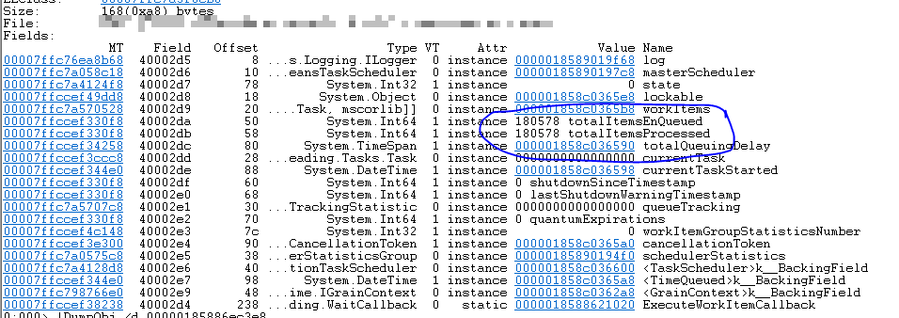
Example of evidence

Slide 28
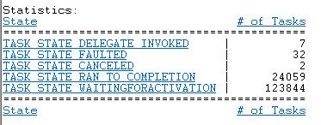
Example of evidence

Slide 29
4 & 5) Make changes & check if resolved
Make relevant changes (less allocations, remove references etc.)
It is possible that the original theory wasn't correct!
Rinse and repeat as needed

Slide 30
F-Reachable queue
Elements in f-reachable
roots during mark phase
"live" in Gen2 while in f-reachable
Cease to become roots after GC

Slide 31
The practical side of things...
Part 3

Slide 32
Memory dumps, when?
High resource usage (CPU/RAM)
Process hangs/crashes
Inefficiencies/slowdowns
Note: memory dumps are a last resort!​

Slide 33
Not only WinDbg!
Any memory profiler
PerfView
VMMap, Process Monitor, ProcDump (SysInternals)
Debug Diagnostic Tool
Visual Studio (parallel stacks!)
.Net CLI tools

Slide 34
Linux – where to start?
Valgrind
LLDB
GDB
.Net CLI tools
vmstat, htop, other bash tools
https://github.com/microsoft/ProcDump-for-Linux

Slide 35
Investigating in Linux
SOS plugin exists for LLDB debugger
Working in LLDB is similar to WinDbg
Install SOS plugin in Linux using dotnet-sos CLI tool
https://github.com/dotnet/diagnostics/blob/master/documentation/sos-debugging-extension.md

Slide 36
.Net CLI Tools
dotnet tool install --global [tool name]
Performance monitoring
https://docs.microsoft.com/en-us/dotnet/core/diagnostics/dotnet-counters
Collect and analyze Windows and Linux dumps.
https://docs.microsoft.com/en-us/dotnet/core/diagnostics/dotnet-dump
Downloads PDBs and DAC files
https://docs.microsoft.com/en-us/dotnet/core/diagnostics/dotnet-symbol
https://github.com/dotnet/diagnostics/blob/master/documentation/dotnet-counters-instructions.md

Slide 37
WinDbg
How and what?

Slide 38
WinDbg?
Windows-only debugger
Can debug kernel and user-mode
Not only post-mortem! Can do live debugging

Slide 39
SOS debugging extension (Son of Strike)
WinDBG extension that allows debugging .Net processes
SOS depends on Windows version!
Especially relevant for dumps from another machine
New WinDbg will fetch SOS automatically
Use dotnet-sos for Linux or old WinDbg
Load SOS with those commands
.loadby sos clr
.loadby sos coreclr
https://docs.microsoft.com/en-us/dotnet/framework/tools/sos-dll-sos-debugging-extension

Slide 40
Common commands
!dumpheap [-stat] [-mt <>] [-type <>] [-strings] [-min] [-max]
!dumpgen <genNum> [-free] [-stat] [-type <>] [-nostrings] (SOSEX)
!gcroot <objectAddr> [-nostacks]
!refs <objectAddr> [-target|-source] (SOSEX)
!finalizequeue
!finq [genNum] [-stat] (SOSEX)
!frq [-stat]
!objsize <addr>
!do <address>
!mdt [typename | MT] [addr] [-r[:level]] [-e[:level]] (SOSEX)

Slide 41
Useful extensions
SOSEX - http://www.stevestechspot.com/downloads/sosex_64.zip
GSOSE (Grand Son Of Strike) - https://github.com/chrisnas/DebuggingExtensions
MEX Debugging Extension - https://github.com/REhints/WinDbg/tree/master/MEX
.load [path to extension dll]
Note: GSOSE and MEX don't work with .Net Core

Slide 42
Useful reading materials
.Net Book of Runtime
https://blog.reverberate.org/2013/05/deep-wizardry-stack-unwinding.html
https://eli.thegreenplace.net/2011/09/06/stack-frame-layout-on-x86-64/
https://github.com/dotnet/docs/blob/master/docs/standard/garbage-collection/index.md
https://mattwarren.org/2017/07/10/Memory-Usage-Inside-the-CLR/

Slide 43
Hands-on practice
Part 4

Slide 44
Hands-on flow
Take a look at the process, it's usage of system resources. Do tracing.
Use Process Explorer to take "Full Dump" and investigate
Once theory is established, take a look at code
If needed, take a look at dump again
Conclusions, perhaps a fix

Slide 45
Summary
Dumps are most useful to investigate issues in production
WinDbg can and should be used together with other tools
Memory leaks in .Net can have multiple possible symptoms
Dump investigation: common sense + technical knowledge + code behavior
Dump investigation is unpredictable
More often than not, managed memory leak = reference leak

Slide 46
Some more recommended reading materials
http://journal.stuffwithstuff.com/2013/12/08/babys-first-garbage-collector/
https://mattwarren.org/2016/06/20/Visualising-the-dotNET-Garbage-Collector/
https://github.com/dotnet/coreclr/blob/master/Documentation/botr/garbage-collection.md
https://mattwarren.org/2017/07/10/Memory-Usage-Inside-the-CLR/
https://mattwarren.org/2017/01/13/Analysing-Pause-times-in-the-.NET-GC/

Slide 47

Questions?
michael.yarichuk@gmail.com
@myarichuk
https://github.com/myarichuk
http://www.graymatterdeveloper.com/

